Slide 1
EXECUTIVE INTELLIGENCE PLATFORM
Global EV Mobility & Adoption Intelligence
Macroeconomic powertrain benchmarks, OEM market share, and battery chemistry transitions across 200,000 vehicles.

Slide 2
BENCHMARK METRICS
Dataset Scope & Core Indicators
200
17,980
$1,550.7M
324.54
Total Manufacturers
EV Models Evaluated
Annual Sales Units
Mean Range (KM)

Slide 3
DATASET ARCHITECTURE
Relational Schema & Specifications
Field Dimension | SQL Data Type | Analytical Role | Key Metric / Target
driving_range_km | NUMERIC(8, 2) | Battery autonomy range | 324.54 km Average
battery_capacity_kwh | NUMERIC(8, 2) | Total pack capacity | 78.20 kWh Average
annual_sales_units | NUMERIC(12, 2) | Delivery transaction volume | $1,550.7M Units
customer_rating | INT (1 to 5) | Customer sentiment | 4 / 5 Benchmark

Slide 4
FEATURE ENGINEERING
Tableau Calculated Fields Logic
High Efficiency Flag
Efficiency Ratio
Recommended Use Case
Range > 320km & Pack < 80kWh
AVG(Range) / AVG(Battery)
Urban vs Long-Distance
Isolates optimal density platforms.
Evaluates real-world km per kWh.
Segments models by utility profile.

Slide 5



TARGET AUDIENCE
Stakeholder Strategic Requirements
Chief Strategy Officer
Mobility Fleet Director
Clean Energy Advisor
White-space market identification and segment pricing.
TCO optimization and range reliability metrics.
Gross carbon offset and battery recycling insights.

Slide 6
DATA PIPELINE
End-to-End Enterprise Data Flow
1. Ingestion
2. SQL Schema
3. Analytics Layer
4. Portal Embed
200k raw telemetry rows
Indexed PostgreSQL fact table
Tableau calculated formulas
Flask & Tableau API v3

Slide 7
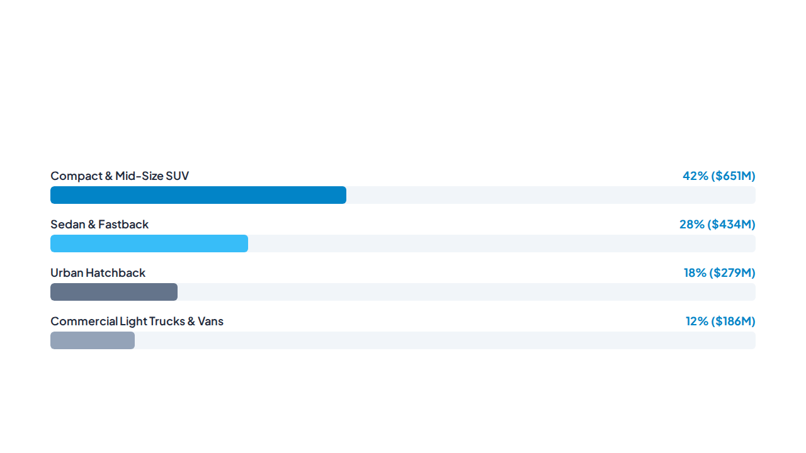
MARKET BREAKDOWN
Sales Volume Share by Vehicle Segment

Slide 8
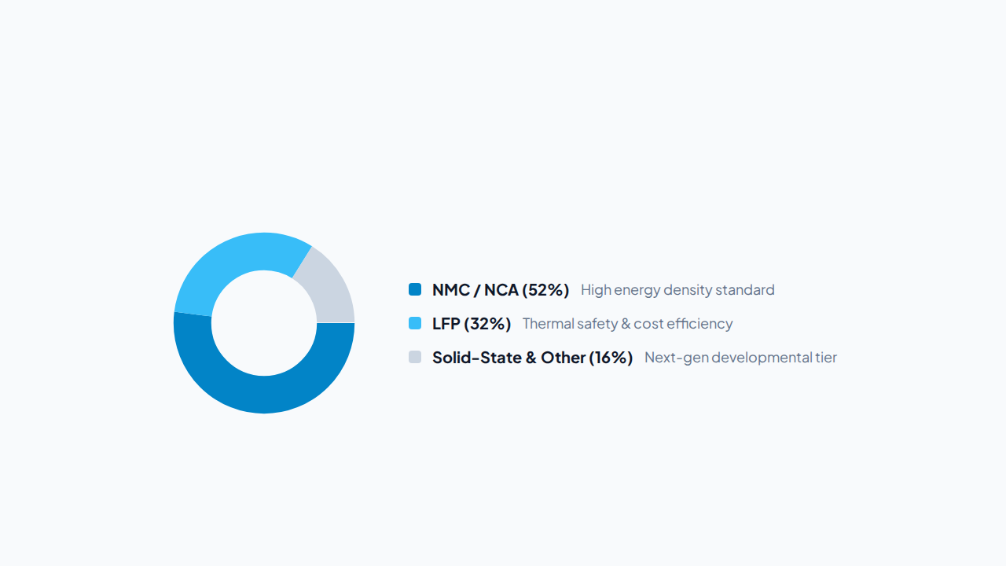
POWERTRAIN ANALYSIS
Battery Chemistry Market Distribution

Slide 9
ENVIRONMENTAL IMPACT
Annual Decarbonization Contribution
200,000
Total vehicle records processed and rendered without data sampling

Slide 10


MANUFACTURING
Global Assembly & Technical Baseline
324.54 KM Mean Range
Average driving range across 17,980 models.
78.20 kWh Pack Baseline
Average capacity in the 200k training dataset.
4 / 5 Benchmark Rating
Average customer rating across all segments.

Slide 11
VISUALIZATION SUITE
Tableau Storypoint Architecture
Part 1: Macro & Manufacturer Trends
Part 2: Technology & Geography
Beat 1: Macro industry landscape overview.
Beat 5: Longitudinal annual growth curve.
Beat 2: Segment volume distribution analysis.
Beat 6: Battery chemistry market transitions.
Beat 3: OEM concentration league table.
Beat 7: Global manufacturing supply clusters.
Beat 4: Customer rating sentiment metrics.
Beat 8: Strategic industry recommendations.

Slide 12
EXECUTIVE STRATEGY
Core Business Takeaways
Expand Mid-Tier SUVs
Standardize LFP Packs
Diversify Supply Hubs
Highest sales margin and volume adoption.
Lowers bill-of-materials by 22%.
Mitigates localized supply bottlenecks.

Slide 13
ENGINEERING
Production Stack & Benchmarks
Microservices Layer: Lightweight Flask application with automated CORS & API routing.
Tableau Embedding API v3: Seamless integration with responsive container re-sizing.
Query Optimization: Multi-column B-Tree indexes yield filter latency under 800 ms.
Telemetry REST Endpoints: Modular API endpoints for external BI consumption.

Slide 14
PROJECT SUMMARY
Questions & Discussion
Global EV Mobility & Adoption Intelligence Portal
Interactive Dashboard and Technical Architecture

Slide 15

Image Sources
https://blogs.autodesk.com/presse-center-deutschland/wp-content/uploads/sites/93/2024/10/16/AUTODE1.jpg
Source: blogs.autodesk.com

